Slide 1

FIFA World Cup Analysis

Slide 2
Introduction
The FIFA World Cup is the most prestigious tournament in international football, held every four years and organized by the Fédération Internationale de Football Association (FIFA). This analysis delves into the comprehensive data spanning multiple editions of the World Cup, covering a wide array of metrics and events that have shaped the history of the tournament.
FIFA World Cup Analysis

Slide 3
Problem Statement
With FIFA is in the blood of many people of the world. You are tasked to tell the story of unsung analysts who put great efforts to provide accurate data to answer every question of fans. The FIFA World Cup is a global football competition contested by the various football-playing nations of the world. It is contested every four years and is the most prestigious and important trophy in the sport of football. The World Cups dataset shows all information about all the World Cups in history, while the World Cup Matches dataset shows all the results from the matches contested as part of the cups. Find key metrics and factors that influence the World Cup win. Do your own research and come up with your findings.

Slide 4
Details of Data
The analysis is based on three comprehensive datasets: -
1. World Cups Dataset
Year: The year the World Cup took place.
Country: The host country for the tournament.
Winner: The team that won the World Cup.
Runners-Up: The team that finished in second place.
Third: The team that secured third place.
Fourth: The team that finished in fourth place.
GoalsScored: Total number of goals scored throughout the tournament.
QualifiedTeams: Number of teams that qualified for the tournament.
MatchesPlayed: Total number of matches played.
Attendance: Total number of spectators who attended the matches.

Slide 5
Details of Data
2. World Cup Matches Dataset
Datetime: Date and time of the match.
Stage: Stage of the tournament (e.g., Group Stage, Quarter-finals, Semi-finals, Final).
Stadium: Stadium where the match was held.
City: City hosting the match.
Home Team Name: Name of the home team.
Home Team Goals: Goals scored by the home team.
Away Team Goals: Goals scored by the away team.
Away Team Name: Name of the away team.
Win Conditions: Conditions under which the match was won (e.g., extra time, penalties).
Attendance: Number of spectators attending the match.
Half-time Home Goals: Goals scored by the home team by half-time.
Half-time Away Goals: Goals scored by the away team by half-time.
Referee: Name of the referee officiating the match.
Assistant 1 & Assistant 2: Names of the assistant referees.
RoundID: Identifier for the round in which the match was played.
MatchID: Unique identifier for the match.
Home Team Initials: Initials of the home team.
Away Team Initials: Initials of the away team.

Slide 6
Details of Data
3. World Cup Players Dataset
RoundID: Identifier for the round in which the player participated.
MatchID: Unique identifier for the match.
Team Initials: Initials of the team.
Coach Name: Name of the team's coach.
Line-up: Starting lineup of players for the team.
Shirt Number: Shirt number of each player.
Player Name: Name of each player.
Position: Position played by each player.
Event: Significant events involving players (e.g., goals, yellow/red cards).

Slide 7
Main Tools Used
Python: - For data cleaning, preprocessing, and initial analysis.
Power BI: - For creating interactive visualizations and dashboards.

Slide 8
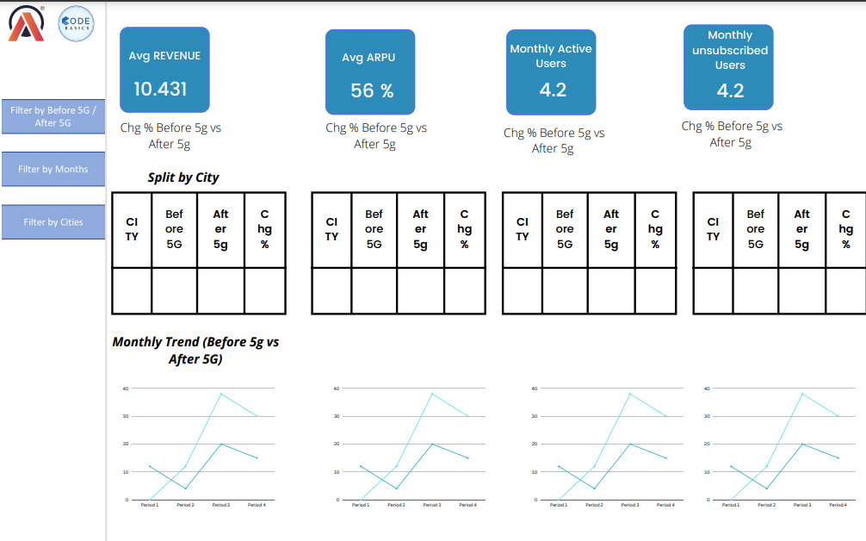
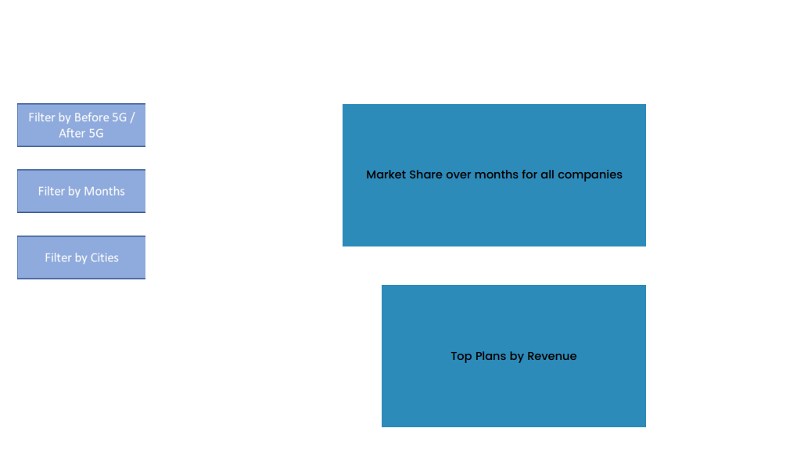
Mock – up Dashboard

Slide 9
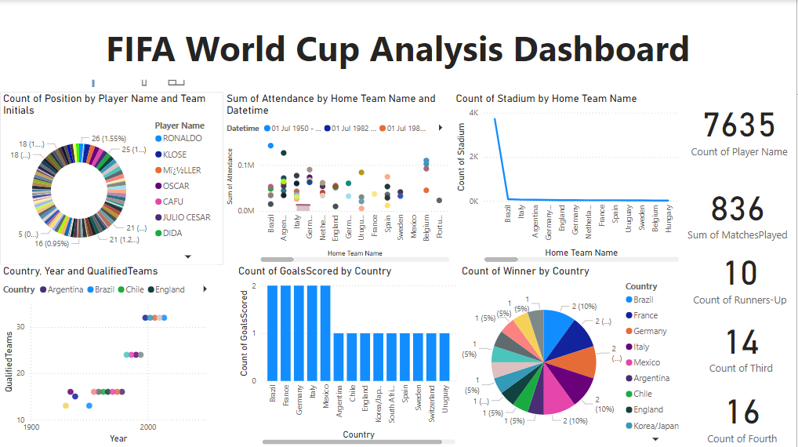
My Design

Slide 10
Thank you

